Slide 1

8086 Pin Configuration
Ready
8086
Microprocessors
A16/S3 – A19/S6
L
A
T
C
H
Clock
Reset
4
BHE/S7
NMI
L
A
T
C
H
AD0–AD15
INTR
16
RD
TEST
MN/ MX
GND
vcc

Slide 2
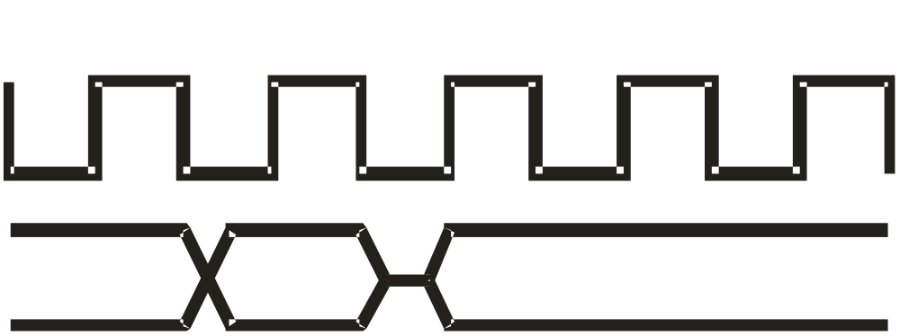
AD0 - AD15: Address Data Bus
AD0 – AD15
Data
Address

Slide 3
A19/S6, A18/S5, A17/S4, A16/S3
Address/Status
A17/S4 | A16/S3 | Function
0 | 0 | Extra segment access
0 | 1 | Stack segment access
1 | 0 | Code segment access
1 | 1 | Data segment access

Slide 4
A18/S5: The status of the
interrupt enable flag bit is updated
at the beginning of each cycle. The status of the flag is indicated through this bus.
A19/S6: When Low, it indicates that 8086 is in control of the bus. During a "Hold acknowledge" clock period, the 8086 tri-states the S6 pin and thus allows another bus master to take control of the status bus.

Slide 5
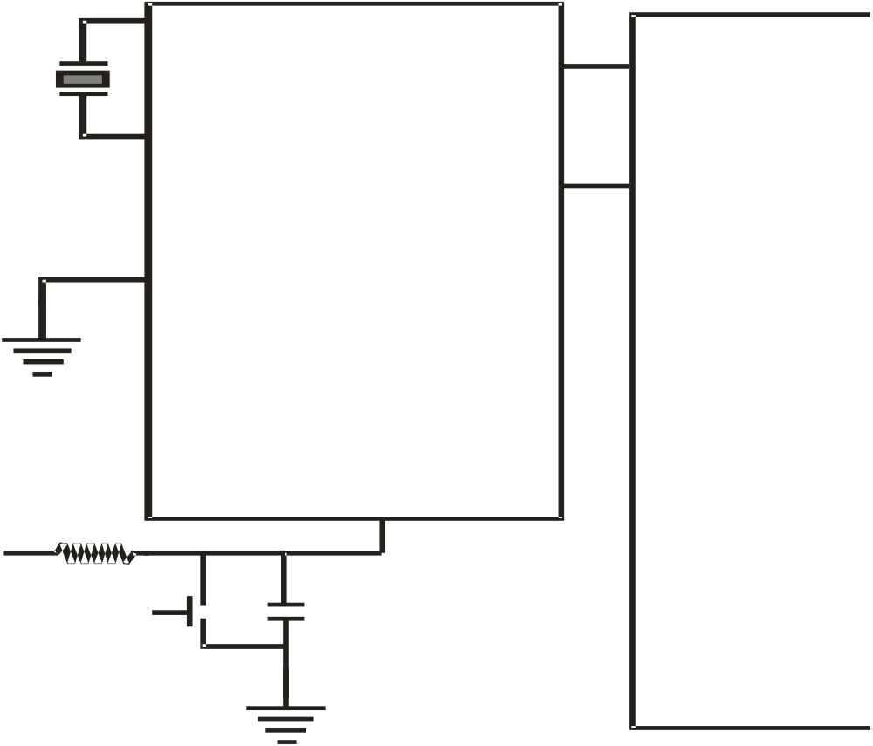
8284 Connected to 8086 Mp
X1
Ready
X2
8086 Microprocessor
AEN1
AEN2
CLK
8284
F/C
Reset
RDY1
RDY2
RES
R
+ 5 V
RESET KEY
C

Slide 6
RESET Operation results
CPU component | Contents
Flags | Cleared
Instruction Pointer | 0000H
CS | FFFFH
DS, SS and ES | 0000H
Queue | Empty

Slide 7
MN / MX common pins
HOLD
RQ / GT0
HLDA
RQ / G1
WR
LOCK
M / IO
S2
8086 Microprocessors
DT / R
S1
DEN
S0
ALE
QS0
INTA
QS1
Minimum Maximum

Slide 8
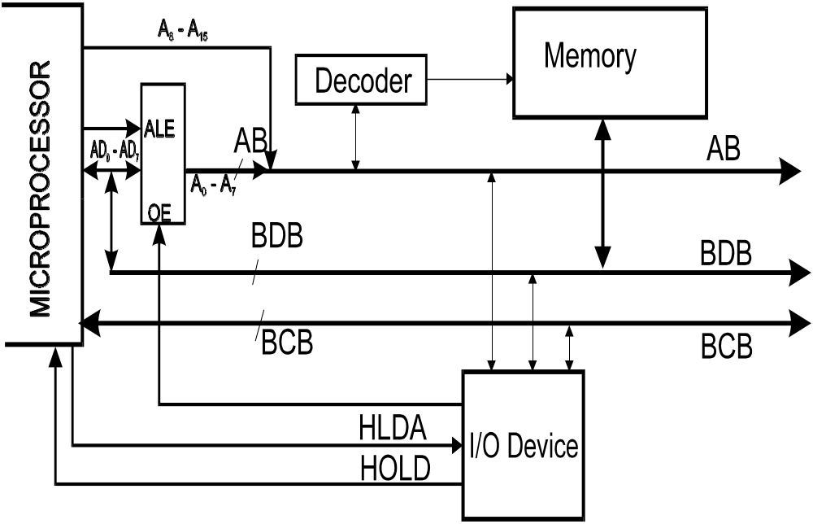
DMA Operation

Slide 9
S2 | S1 | S0 | Characteristics
0 | 0 | 0 | Interrupt acknowledge
0 | 0 | 1 | Read I/O port
0 | 1 | 0 | Write I/O port
0 | 1 | 1 | Halt
1 | 0 | 0 | Code access
1 | 0 | 1 | Read memory
1 | 1 | 0 | Write memory
1 | 1 | 1 | Passive State

Slide 10
QS1 | QS1 | Characteristics
0 | 0 | No operation
0 | 1 | First byte of opcode from queue
1 | 0 | Empty the queue
1 | 1 | Subsequent byte from queue

Slide 11
8086 Memory Addressing
Data can be accessed from the memory in four different ways. They are:
8 - bit data from Lower (Even) address Bank.
8 - bit data from Higher (Odd) address Bank.
16 - bit data starting from Even Address.
16 - bit data starting from Odd Address.

Slide 12
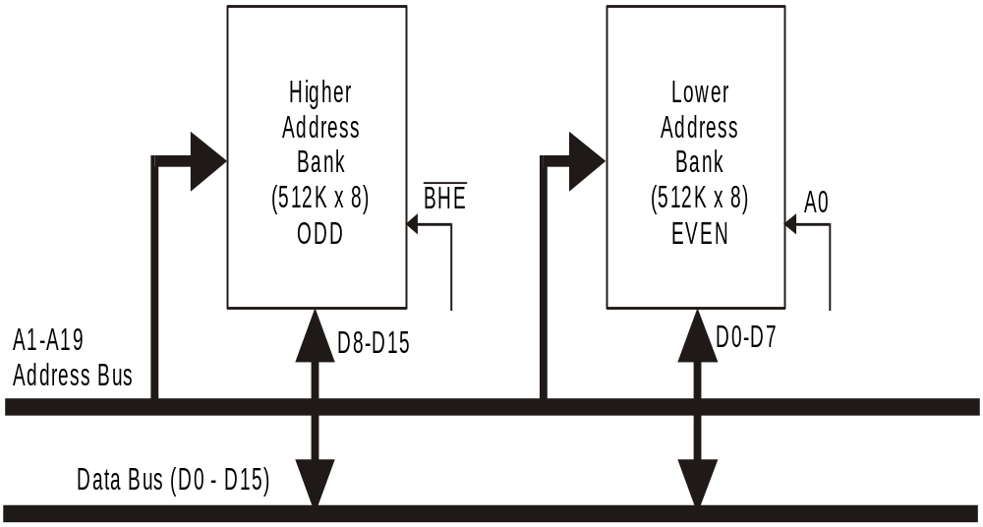

Slide 13
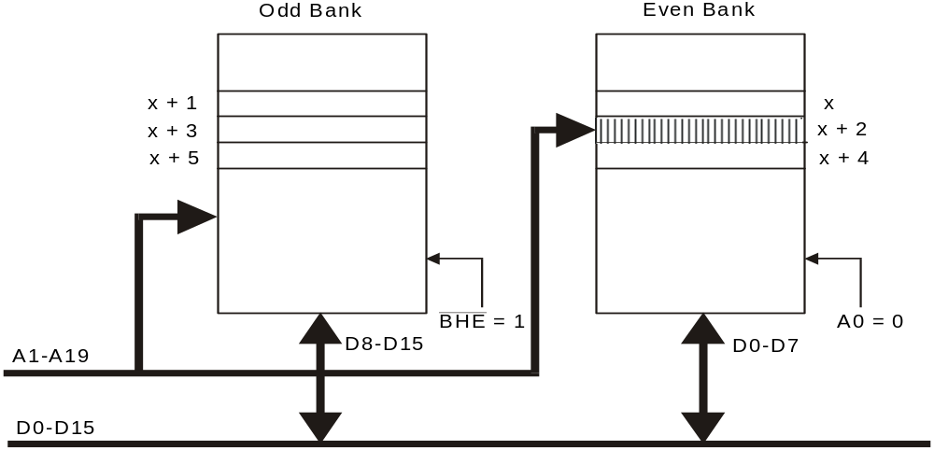
8-bit data from Even address Bank

Slide 14
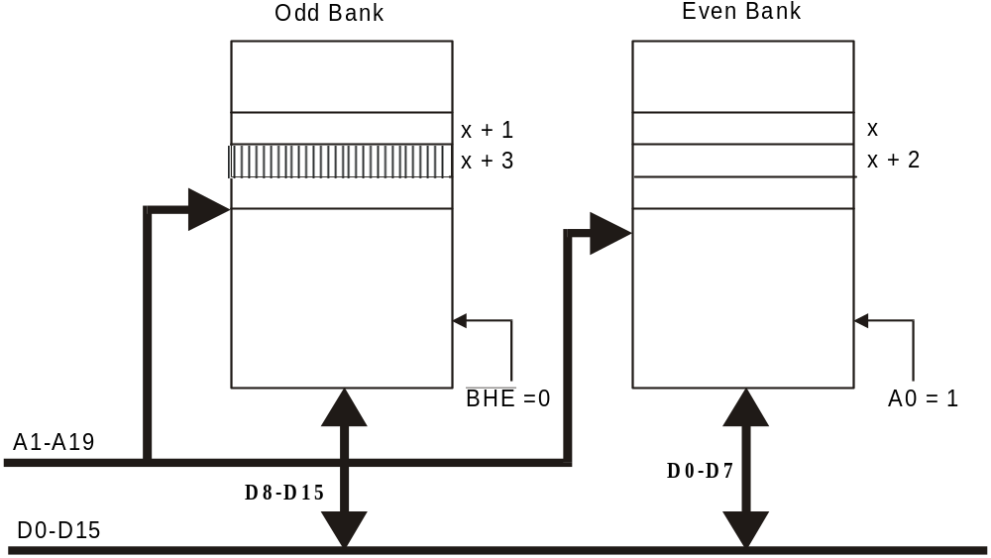
8-bit Data from Odd Address Bank

Slide 15
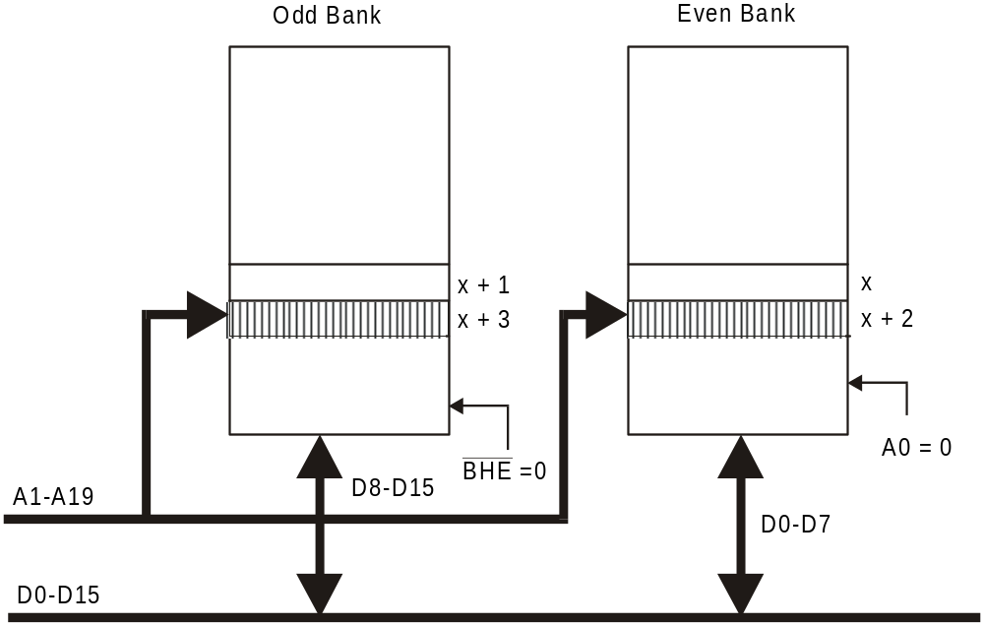
16-bit Data Access starting from Even - Address

Slide 16
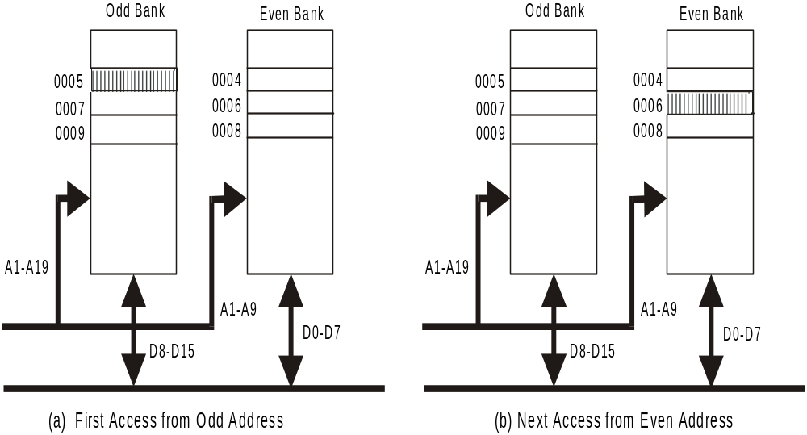
16-bit Data Access starting from Odd Address

Slide 17
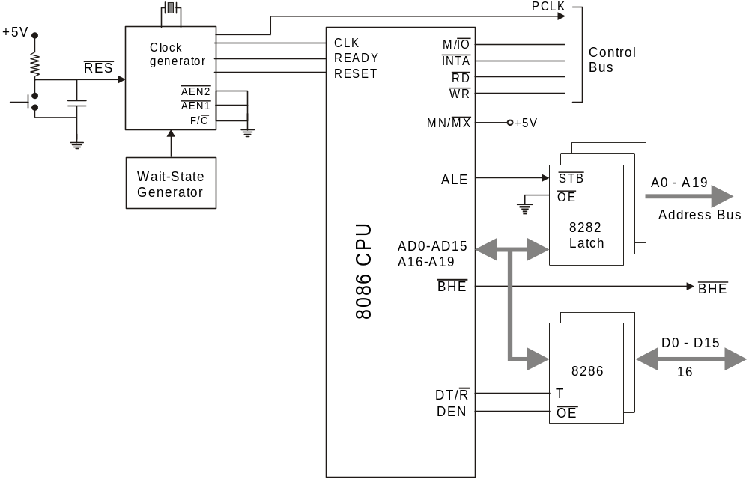
8086 System Minimum mode

Slide 18
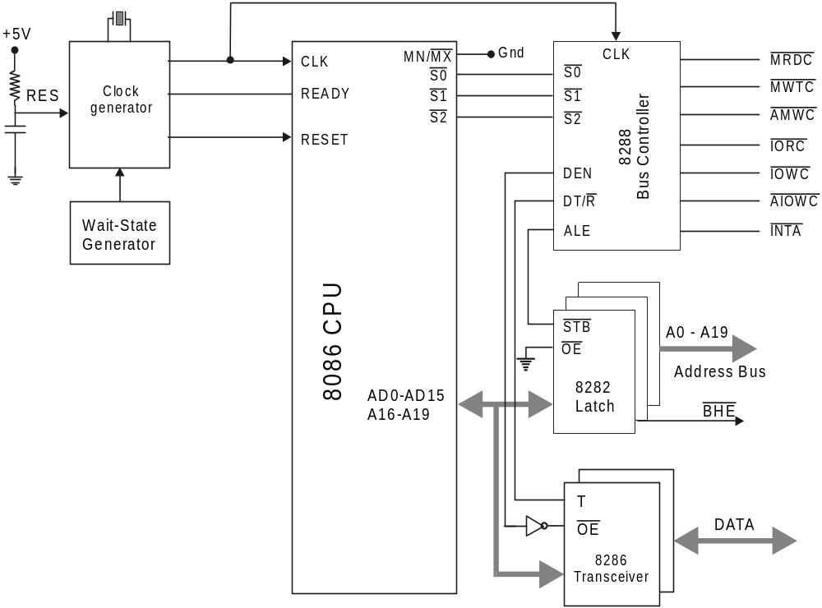
8086 System Maximum Mode

Slide 19
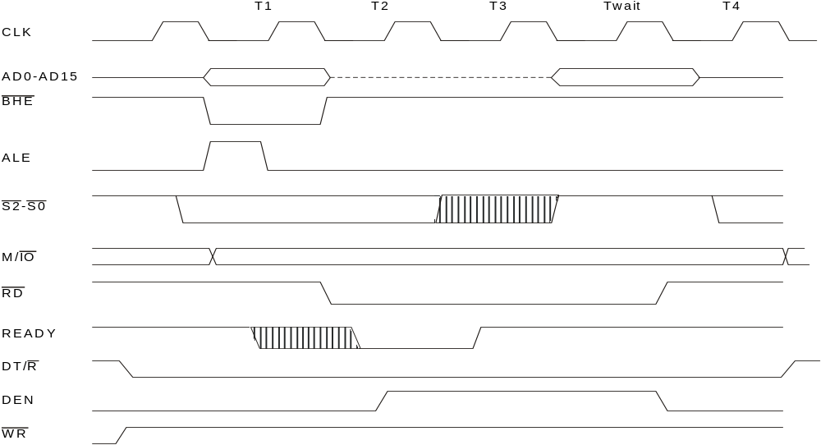
Read Timing Diagram

Slide 20
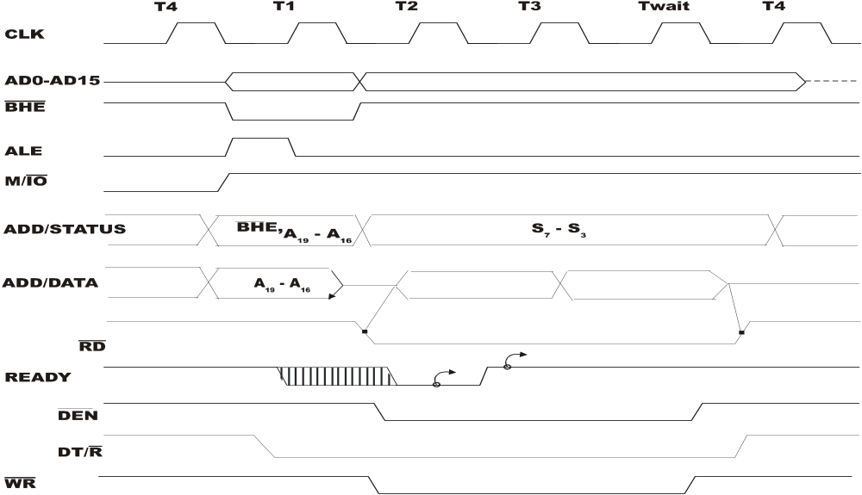
Write Machine Cycle

Slide 21
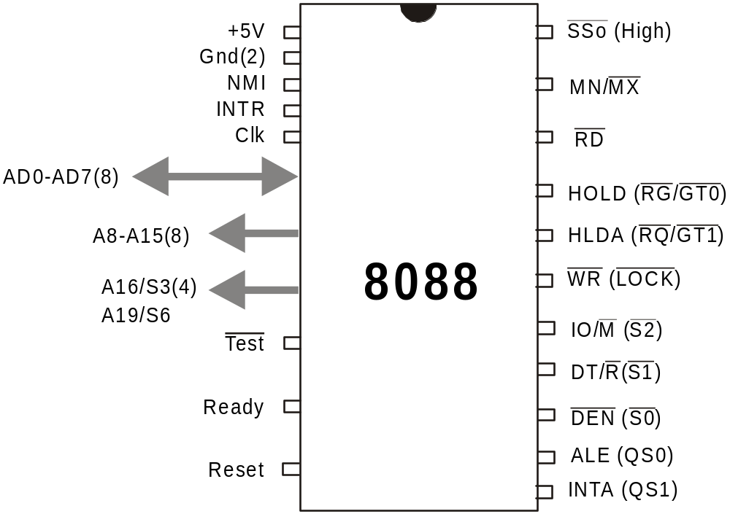
Comparison of 8086 with the 8088 Microprocessor
SS0
IO/M(S2)

Slide 22
The major differences between
8088 and 8086 are outlined below:
The queue length is 4 bytes in the
8088, where as the 8086 queue
comprises of 6 bytes.
The 8088 BIU will fetch a new instruction to load into the queue as soon as it finds a byte hole (space available) in the queue. The 8086 waits until a 2 byte space is available.

Slide 23
The internal execution time of the instruction set is affected by the 8-bit interface. All 16-bit fetches and writes from / to memory take an additional four clock cycles. The CPU is also limited by the speed of instruction fetch. When the more sophisticated instructions of the 8088 are being used, the queue has time to fill and the execution proceeds as fast as the execution unit will allow.

Slide 24
A8-A15: These pins are only address outputs on the 8088. These address lines are latched internally and remain valid throughout a bus cycle in a manner similar to the 8085 upper address lines.
provides the status information in the minimum mode. This output occurs on pin 34 in minimum mode only. DT/R, IO/M and SS0 provide the complete bus status in minimum mode.

Slide 25
IO/M | DT/R | SSO | CHARACTERISTICS
0 | 0 | 0 | Code Access
0 | 0 | 1 | Read Memory
0 | 1 | 0 | Write Memory
0 | 1 | 1 | Passive
1 | 0 | 0 | Interrupt Acknowledge
1 | 0 | 1 | Read I/O port
1 | 1 | 0 | Write I/O port
1 | 1 | 1 | Halt

Slide 26
BHE has no meaning on the 8088 and has been eliminated.
IO/ M has been inverted. i.e., (In 8086, this pin as IO/M)

Slide 27
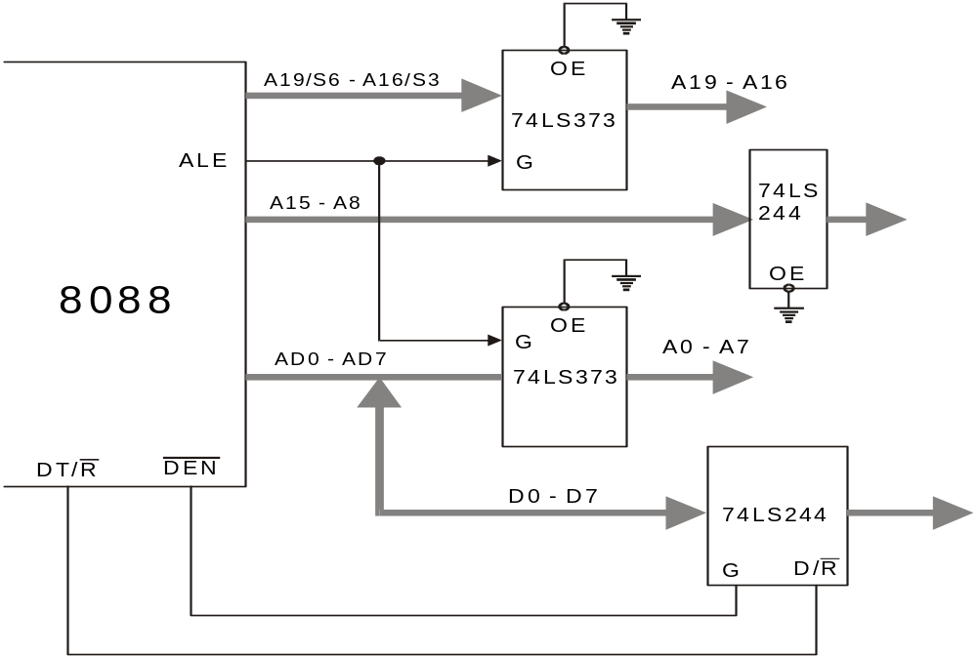

Slide 28
Questions:
Explain the operation of the LOCK pin.
What is the use of QS1 and QS0 pins?
Explain the operation of the TEST pin and the WAIT instruction.
What is the purpose of the status bits S3 and S4?
Compare 8086 and 8088 microprocessors. In what ways are they similar? In what ways do they differ?

Slide 29
6. What is the purpose of the ALE signal in an 8086 system?
7. What is the major difference between an 8086 operating in minimum mode and an 8086 operating in maximum mode?
8. Describe the response of an 8086 when its RESET input is asserted high.
9. Why are buffers often needed on the address, data and control buses in a microprocessor system?

Slide 30
10. What are the function of the 8086 DT/and signals?
11. Explain the difference between a memory read cycle and an I/O read cycle.

